Slide 1

Sentiment Analysis on Product Reviews
Presentation by Sneha Agrawal
MET CS 688

Slide 2
INTROCUDTION
Scraping Amazon product reviews through URL of any product.
Libraries used: requests and BeautifulSoup.
Sentiment analysis using BERT and machine learning models.
User-friendly interface for data extraction, model evaluation and prediction

Slide 3
PROJECT ARCHITECTURE
WebScrape.py: Scraping reviews, preprocessing data, and sentiment analysis with BERT
train_model.py: Training and saving various machine learning models.
streamlit_app.py: User interface for model evaluation and sentiment prediction

Slide 4
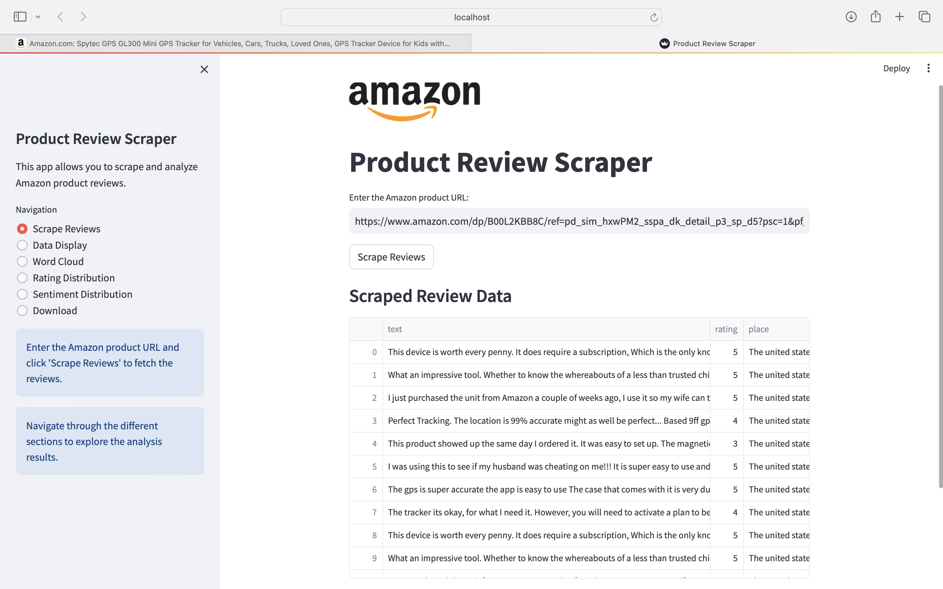
PRODUCT REVIEWS SCRAPER PREVIEW
Product URL used in this presentation:
https://www.amazon.com/dp/B00L2KBB8C/ref=pd_sim_hxwPM2_sspa_dk_detail_p3_sp_d5?psc=1&pf_rd_p=edeb0a3c-9e06-48d9-b1e4-e035133e7101&pf_rd_r=2KPA0W9YJPAEEPSAJ21K&sp_csd=d2lkZ2V0TmFtZT1zcF9kZXRhaWxfdGhlbWF0aWM/ref=pd_sim_hxwPM2_sspa_dk_detail_p3_sp_d5
Last page:
Allows user to download original dataset and resampled dataset

Slide 5
DATA PRE-PROCESSING
Handling missing values
Translating reviews to English
Cleaning and formatting the data
Sentiment analysis using pre-trained Bert model which will later be fine- tuned.
Oversampling to solve issue of imbalance classs.
Library used: SMOTE from imblearn.over_sampling
Scraped data is saved as resampled_data.csv.

Slide 6
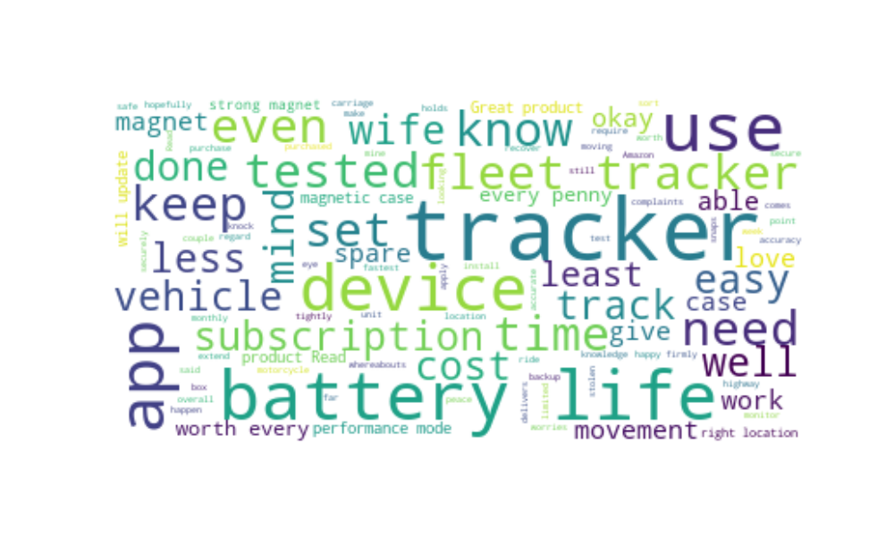

Slide 7
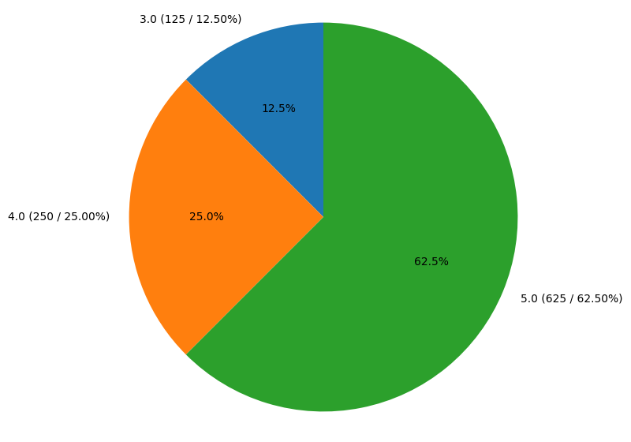
RATING DISTRIBUTION

Slide 8
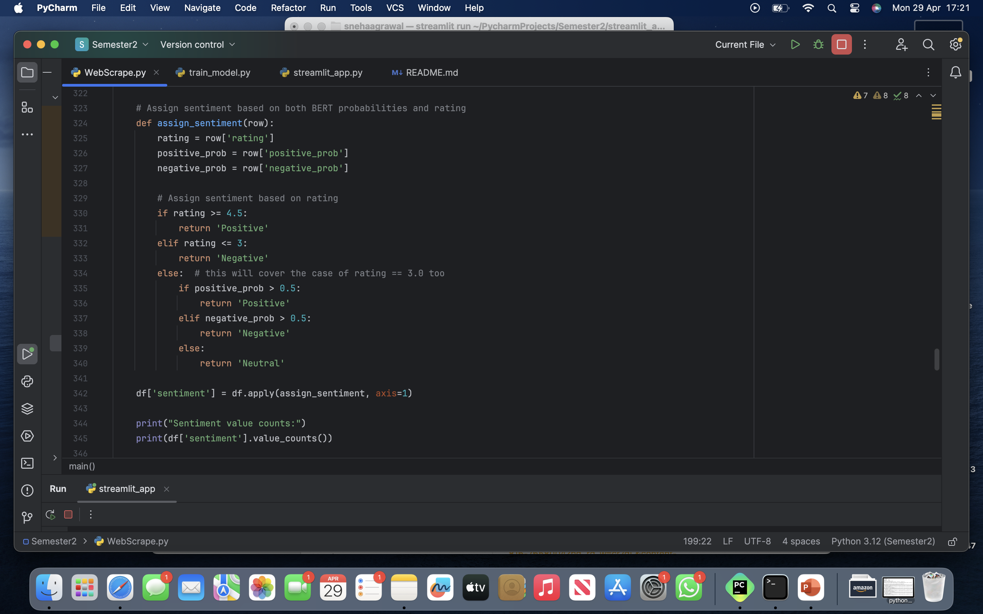
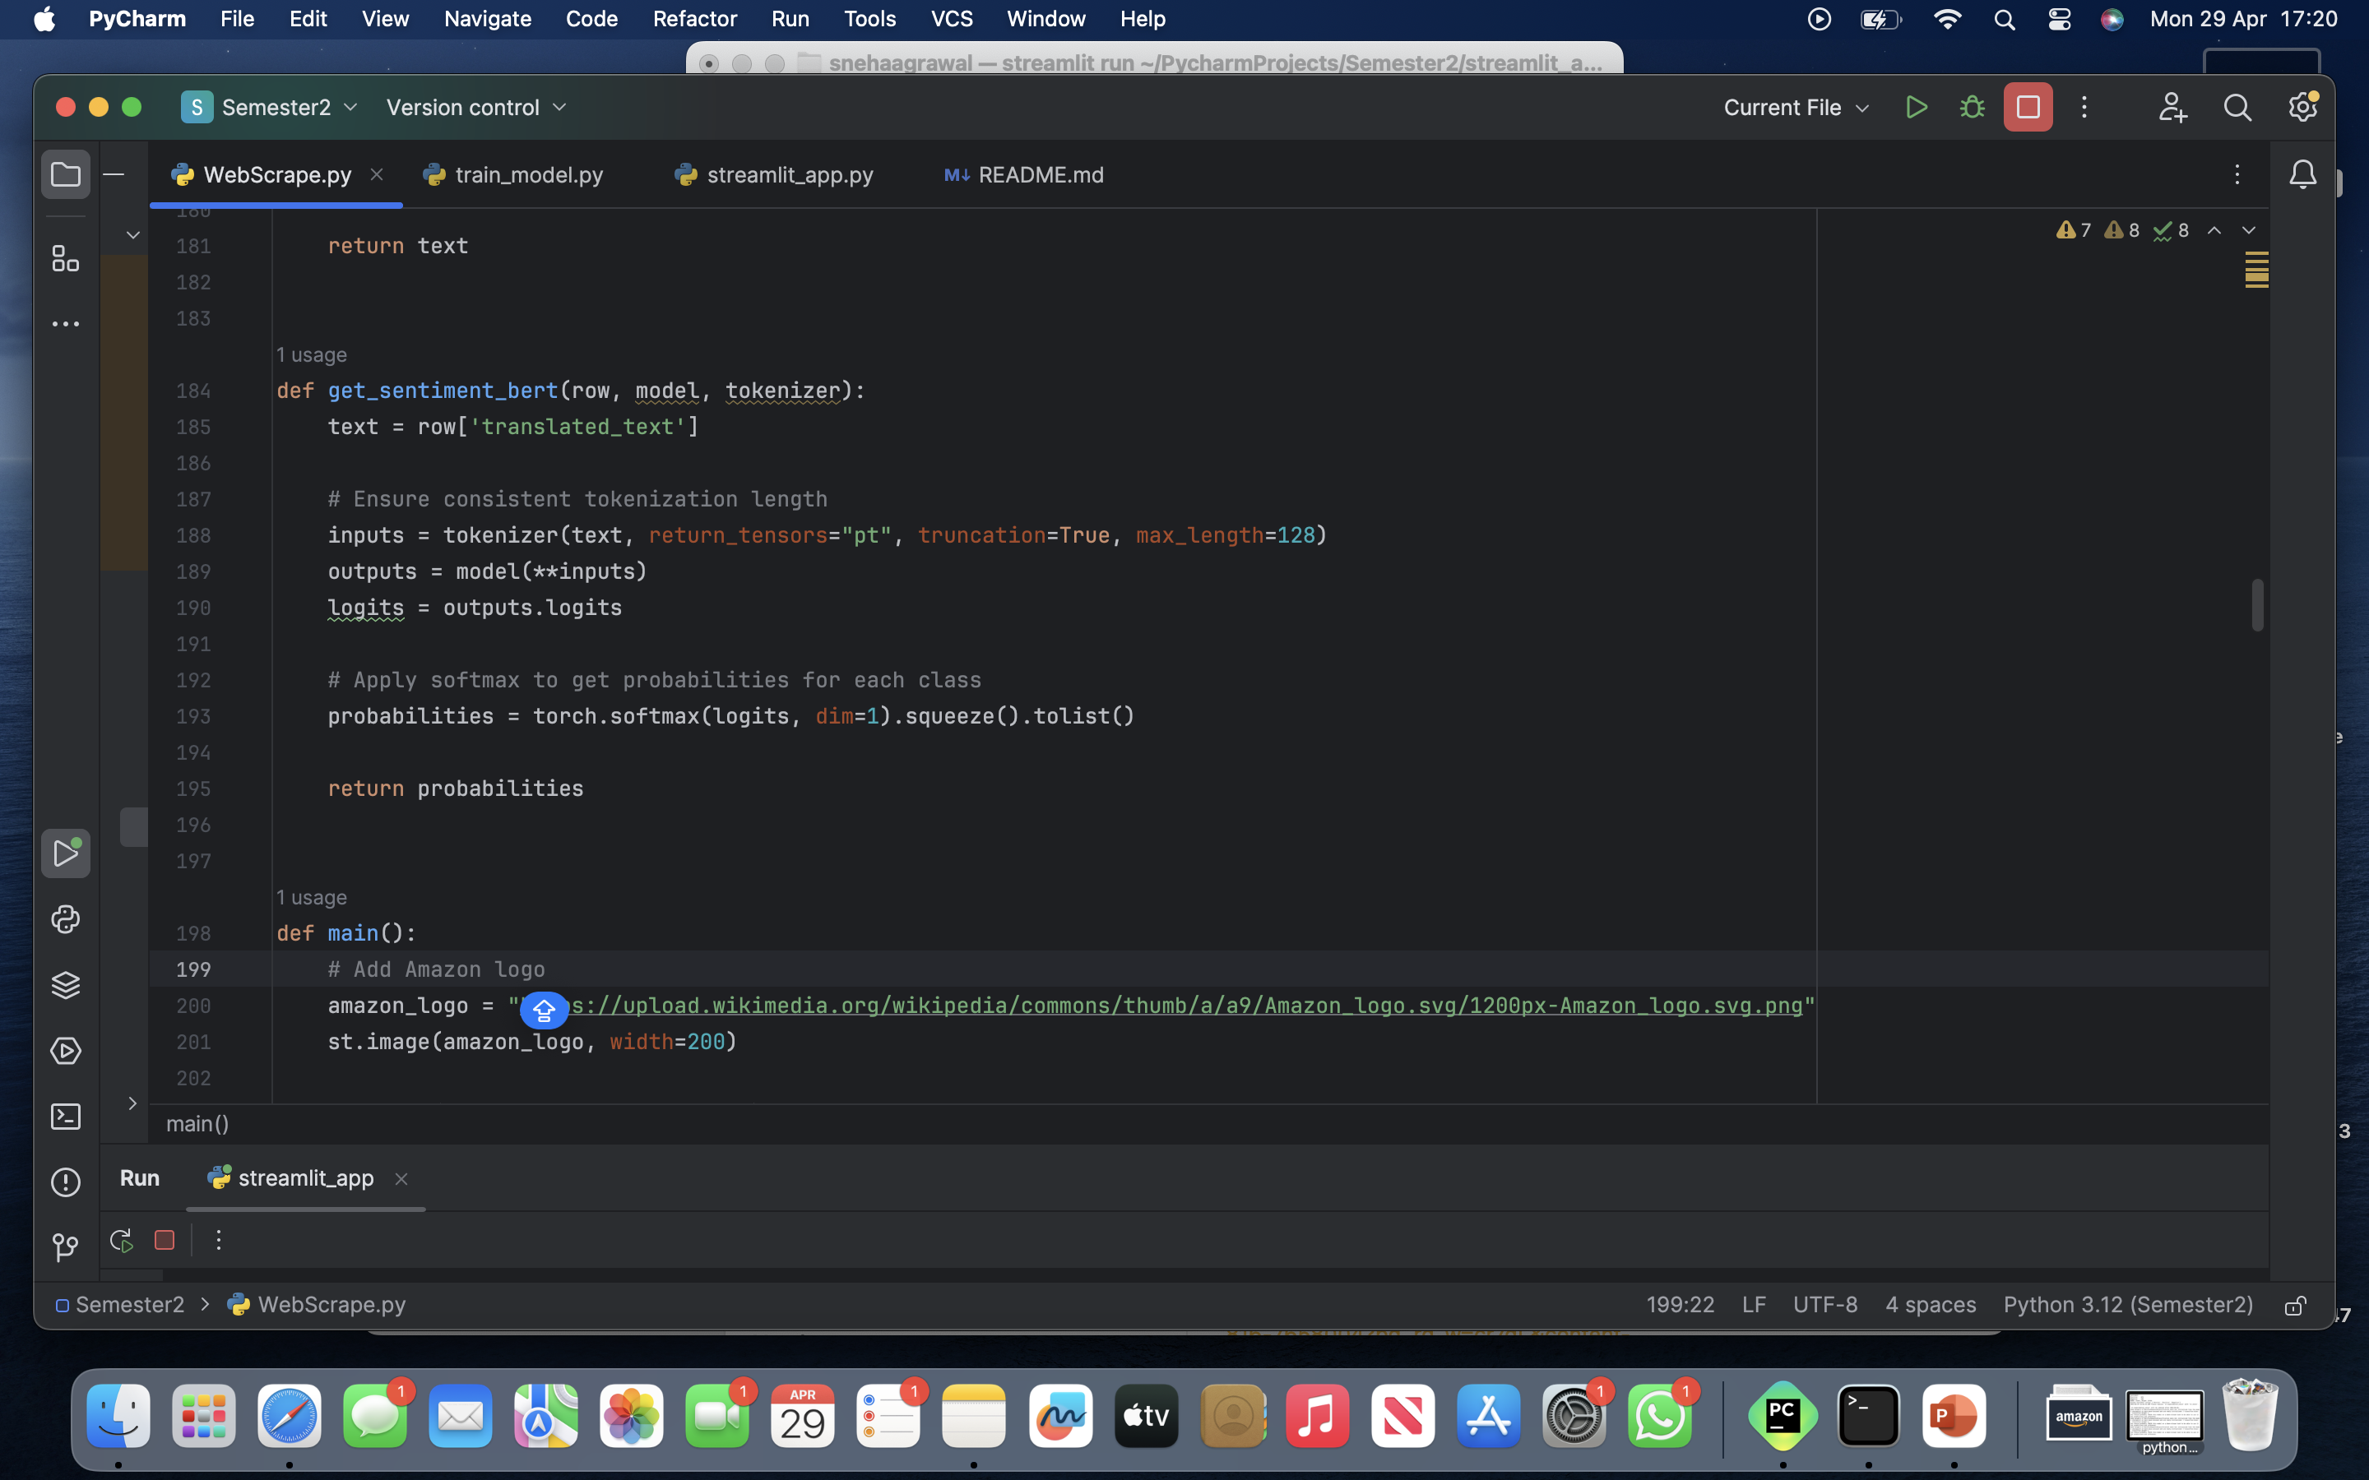
SENTIMENT ANALYSIS APPROACH

Slide 9
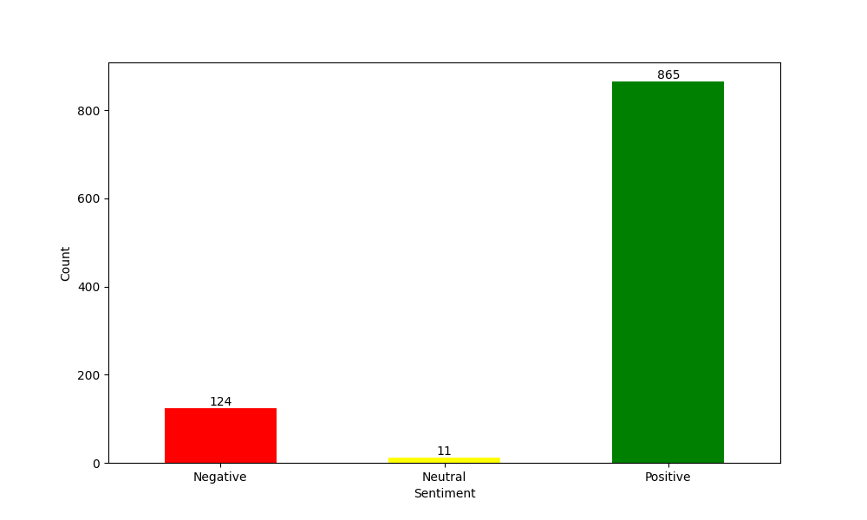
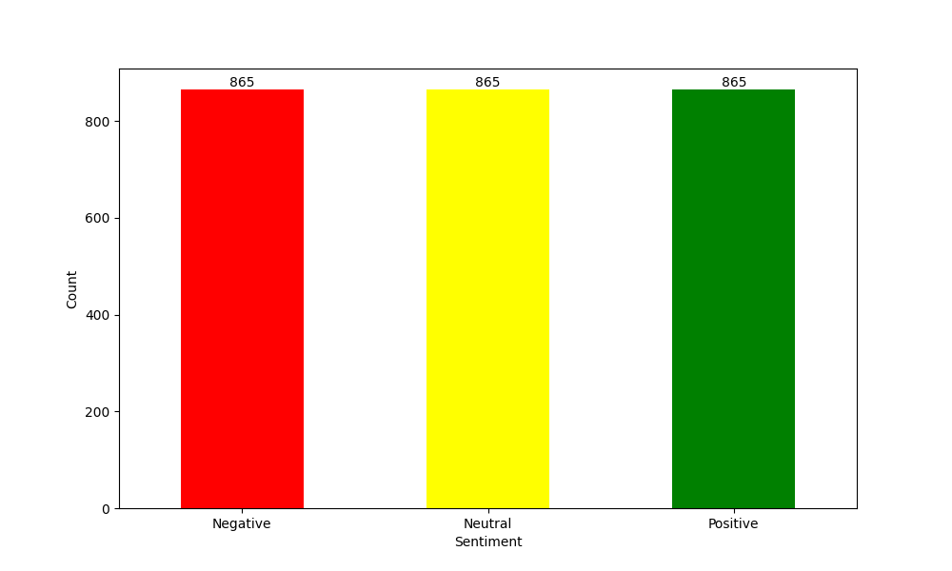
OVERSAMPLING

Slide 10
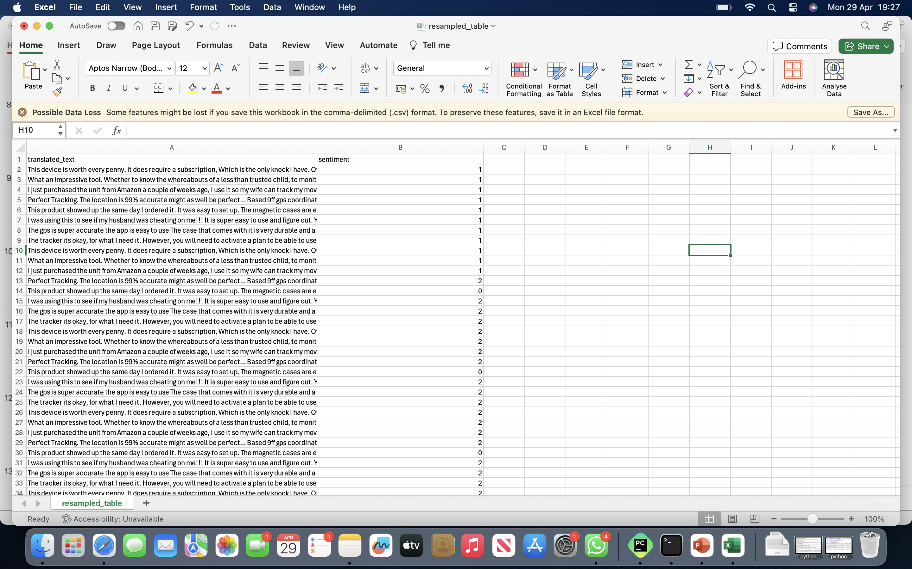
RESAMPLED DATA CSV PREVIEW:
FEATURES: TRANSLATED_TEXT
LABELS: SENTIMENT

Slide 11
DATA SPLIT
The data is split into training and test sets using the train_test_split function from scikit-learn.
The training set contains 80% of the data, while the test set contains the remaining 20%.
The split is stratified based on the 'SENTIMENT' column, ensuring that the class distributions in the train and test sets are approximately the same as the input data.
Cross Validation is used on training set to train the model (5- k folds).
Cross Validation is used on testing set to test and evaluate final results.

Slide 12
TF – IDF VECTORIZATION
TF-IDF (Term Frequency-Inverse Document Frequency) is a statistical measure used to evaluate the importance of a word in a document within a collection of documents.
It is calculated by multiplying two metrics:
Term Frequency (TF): The frequency of a word in a document.
Inverse Document Frequency (IDF): The inverse of the document frequency of a word across the corpus.
TF-IDF assigns higher weights to words that are more important and less frequent across the corpus.
In the project, TF-IDF vectorization is applied to the training data to convert the text into numerical features suitable for machine learning models.

Slide 13
TOKEIZERS FOR BERT AND RoBERTa
Tokenization is the process of splitting text into smaller units called tokens, such as words or subwords.
BERT (Bidirectional Encoder Representations from Transformers) and RoBERTa (Robustly Optimized BERT Pretraining Approach) are pre-trained language models that require specific tokenization techniques.
BERT Tokenizer: uses a WordPiece tokenizer, which splits words into subword units based on a pre-defined vocabulary.
It adds special tokens like [CLS] (classification token) and [SEP] (separator token) to the input sequence.
The tokenizer converts the input text into a sequence of token IDs that can be fed into the BERT model.
RoBERTa Tokenizer: uses a byte-level BPE (Byte-Pair Encoding) tokenizer, which operates at the byte level instead of the character level.
It is based on the GPT-2 tokenizer and has a vocabulary size of around 50,000 tokens.
Similar to BERT, the RoBERTa tokenizer adds special tokens and converts the input text into token IDs.
In the project, the BERT and RoBERTa tokenizers are used to preprocess the input text before feeding it into the respective models for sentiment analysis.

Slide 14
MODELS
Logistic Regression
Naïve Bayes
Support Vector Machine (SVM)
BERT
RoBERTa
Results are displayed through Streamlit (User Interface)

Slide 15
USER INTERFACE
Drop down option to view specific model for evaluation
Comparing the performance of different models
Performing sentiment prediction on user input

Slide 16
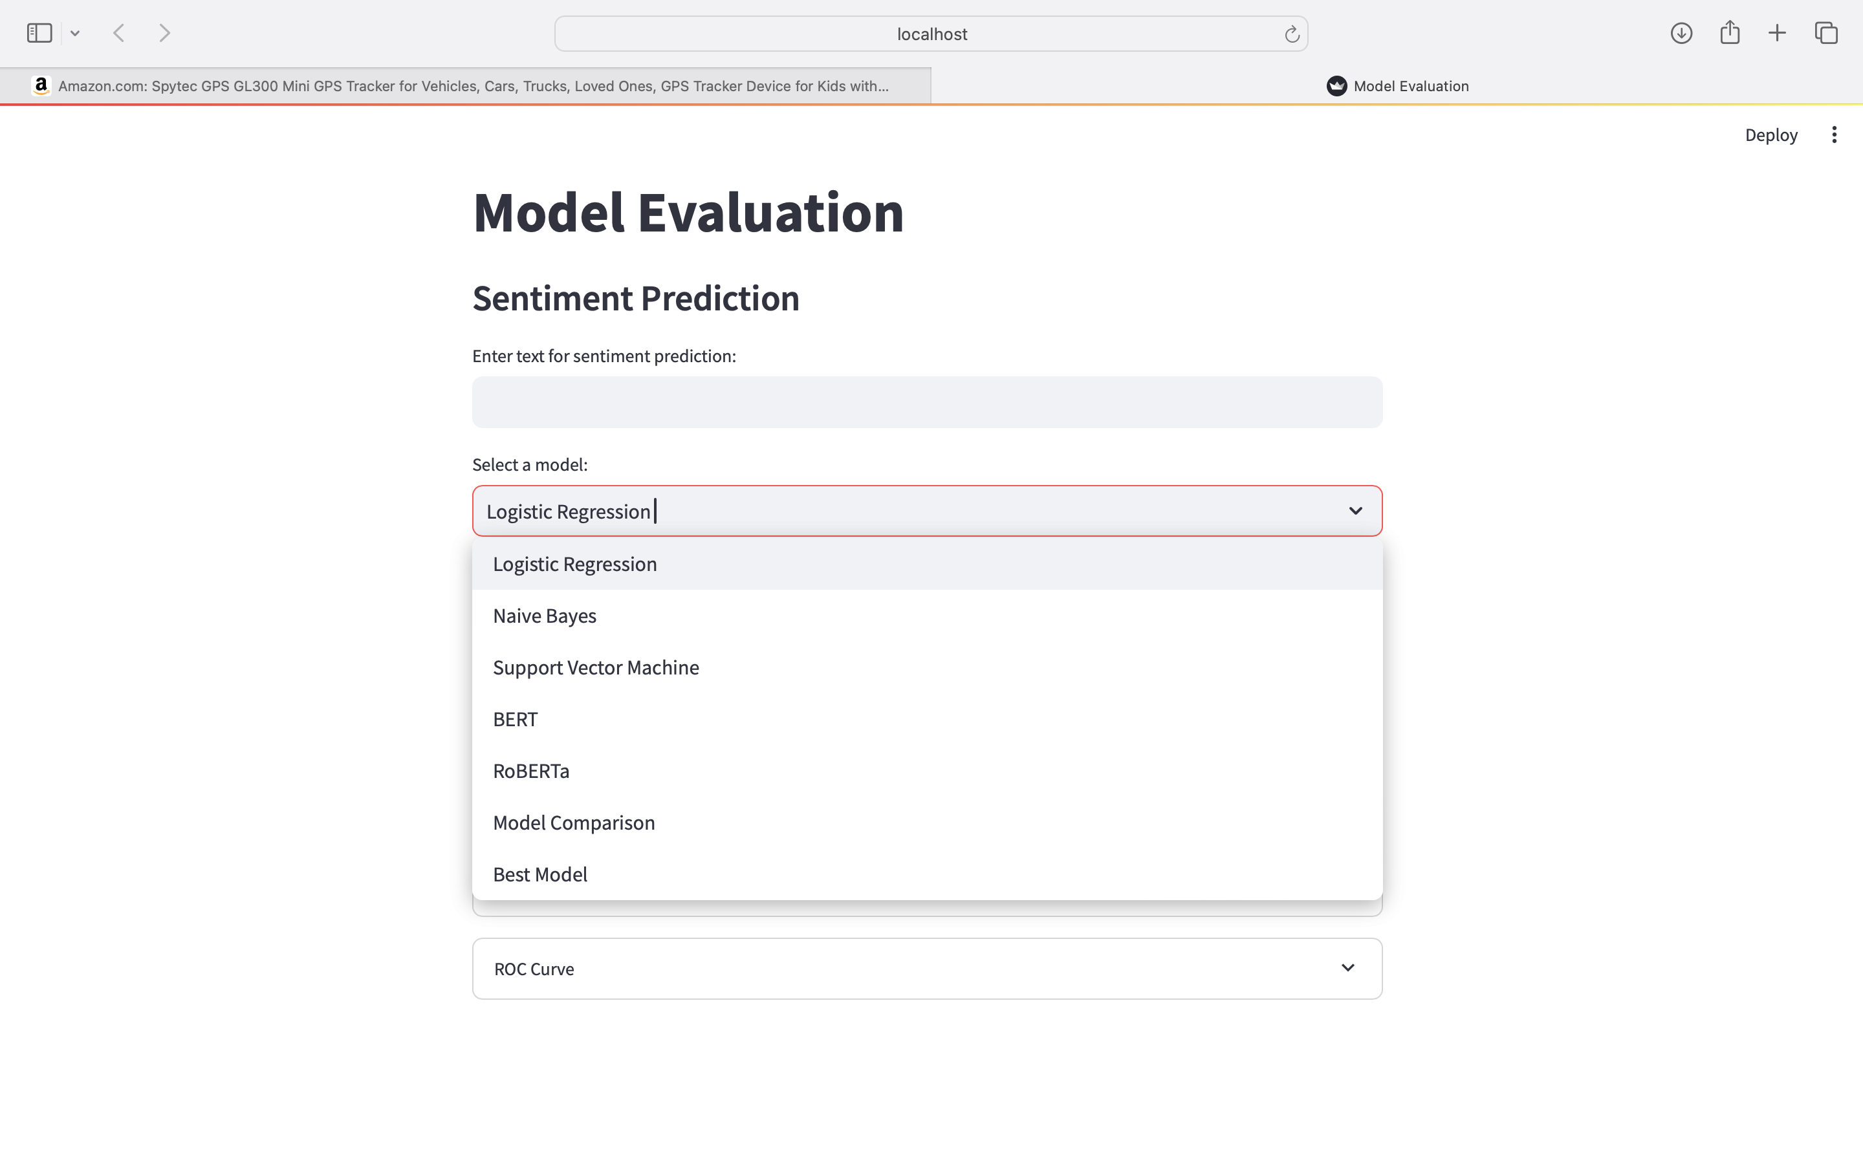
MODEL EVALUTION PAGE PREVIEW:
MAY CHOOSE INDIVIDUAL MODEL ANALYSIS, COMPARISION, BEST MODEL, OR LIVE PREDICTION

Slide 17
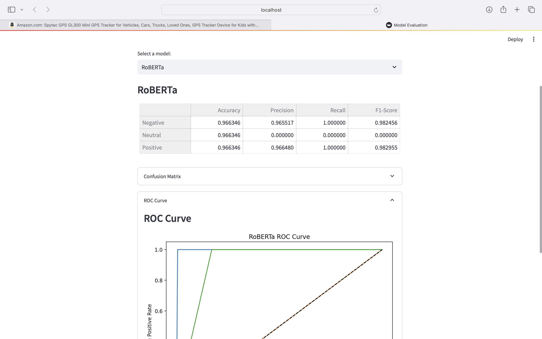
INDIVIDUAL MODEL PREVIEW BY RoBERTa

Slide 18
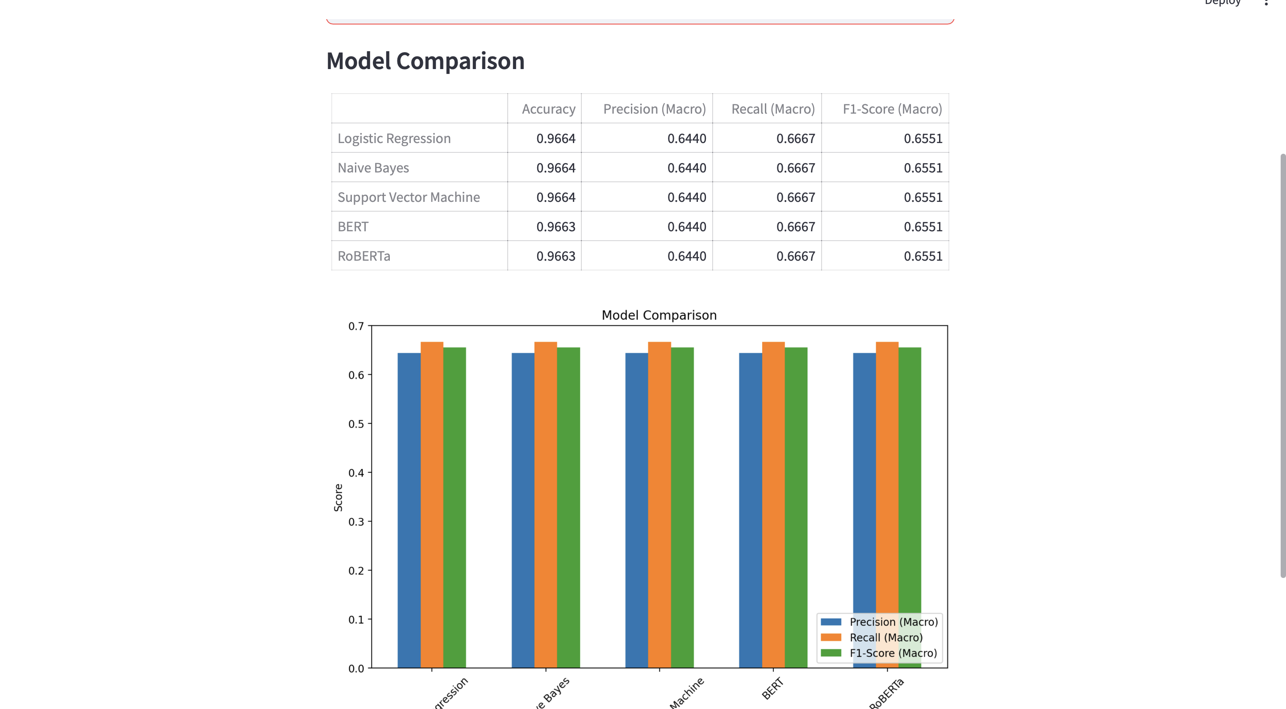

Slide 19
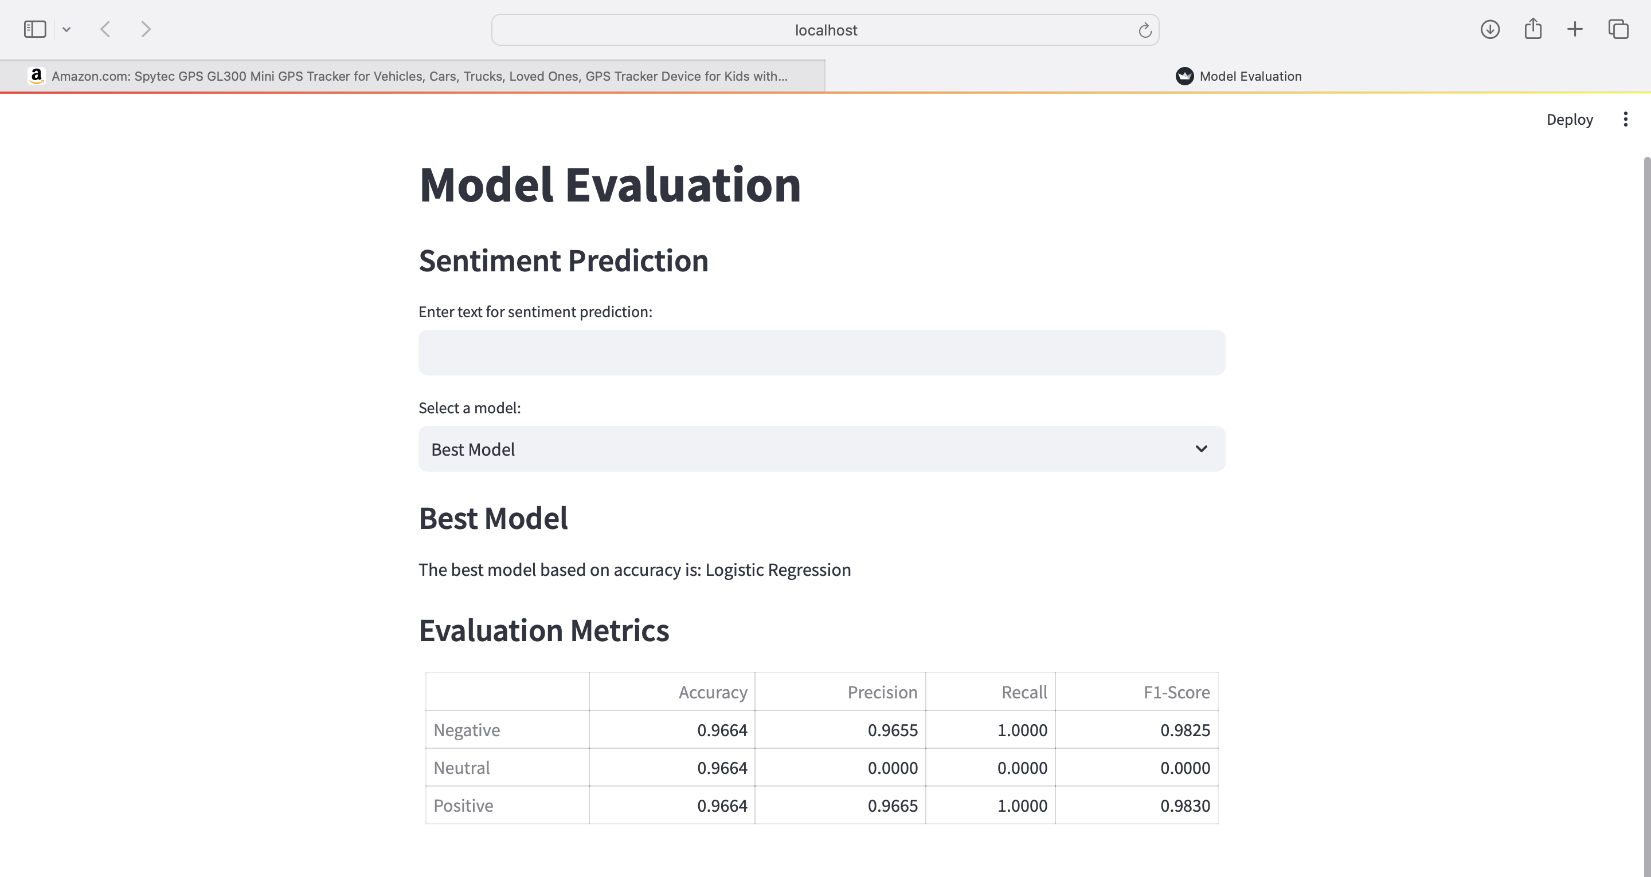

Slide 20
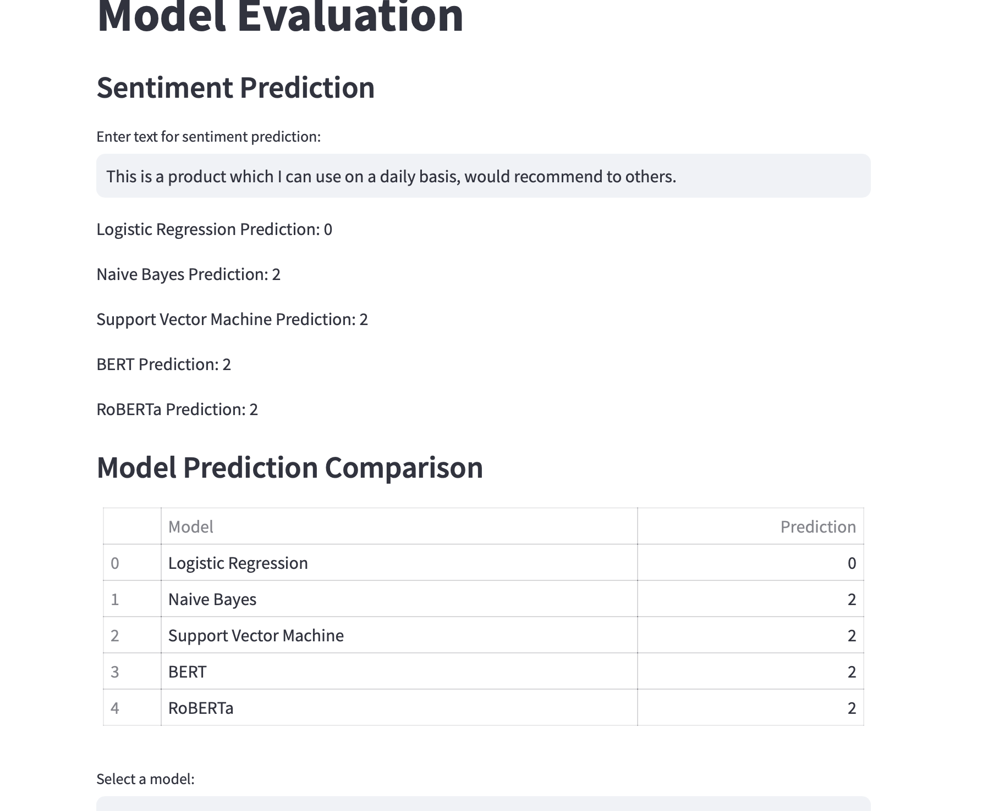
LIVE SENTIMENT ANALYSIS ON UI

Slide 21
LIMITATIONS
Dataset limitations to 1000.
Sentiment Analysis Approach: leverages the predicted probabilities and ratings.
Implement other models which may perform better.

Slide 22
FUTURE ENHANCEMENT
Expand Dataset
Implement Cross-Category Analysis
Implement a more advanced Sentiment Analysis Techniques.
Implement a real-time Sentiment Analysis

Slide 23

THANK YOU

